Slide 1

Functional properties of the particle -o in four Bantu languages
Patrick Kanampiu¹, Allen Asiimwe², Amani Lusekelo³, Ernest Nshemezimana⁴, Jenneke van der Wal⁵
¹The University of Edinburgh, ²Makerere University, ³University of Dar Es Salaam, ⁴University of Burundi, ⁵Leiden University
1

Slide 2
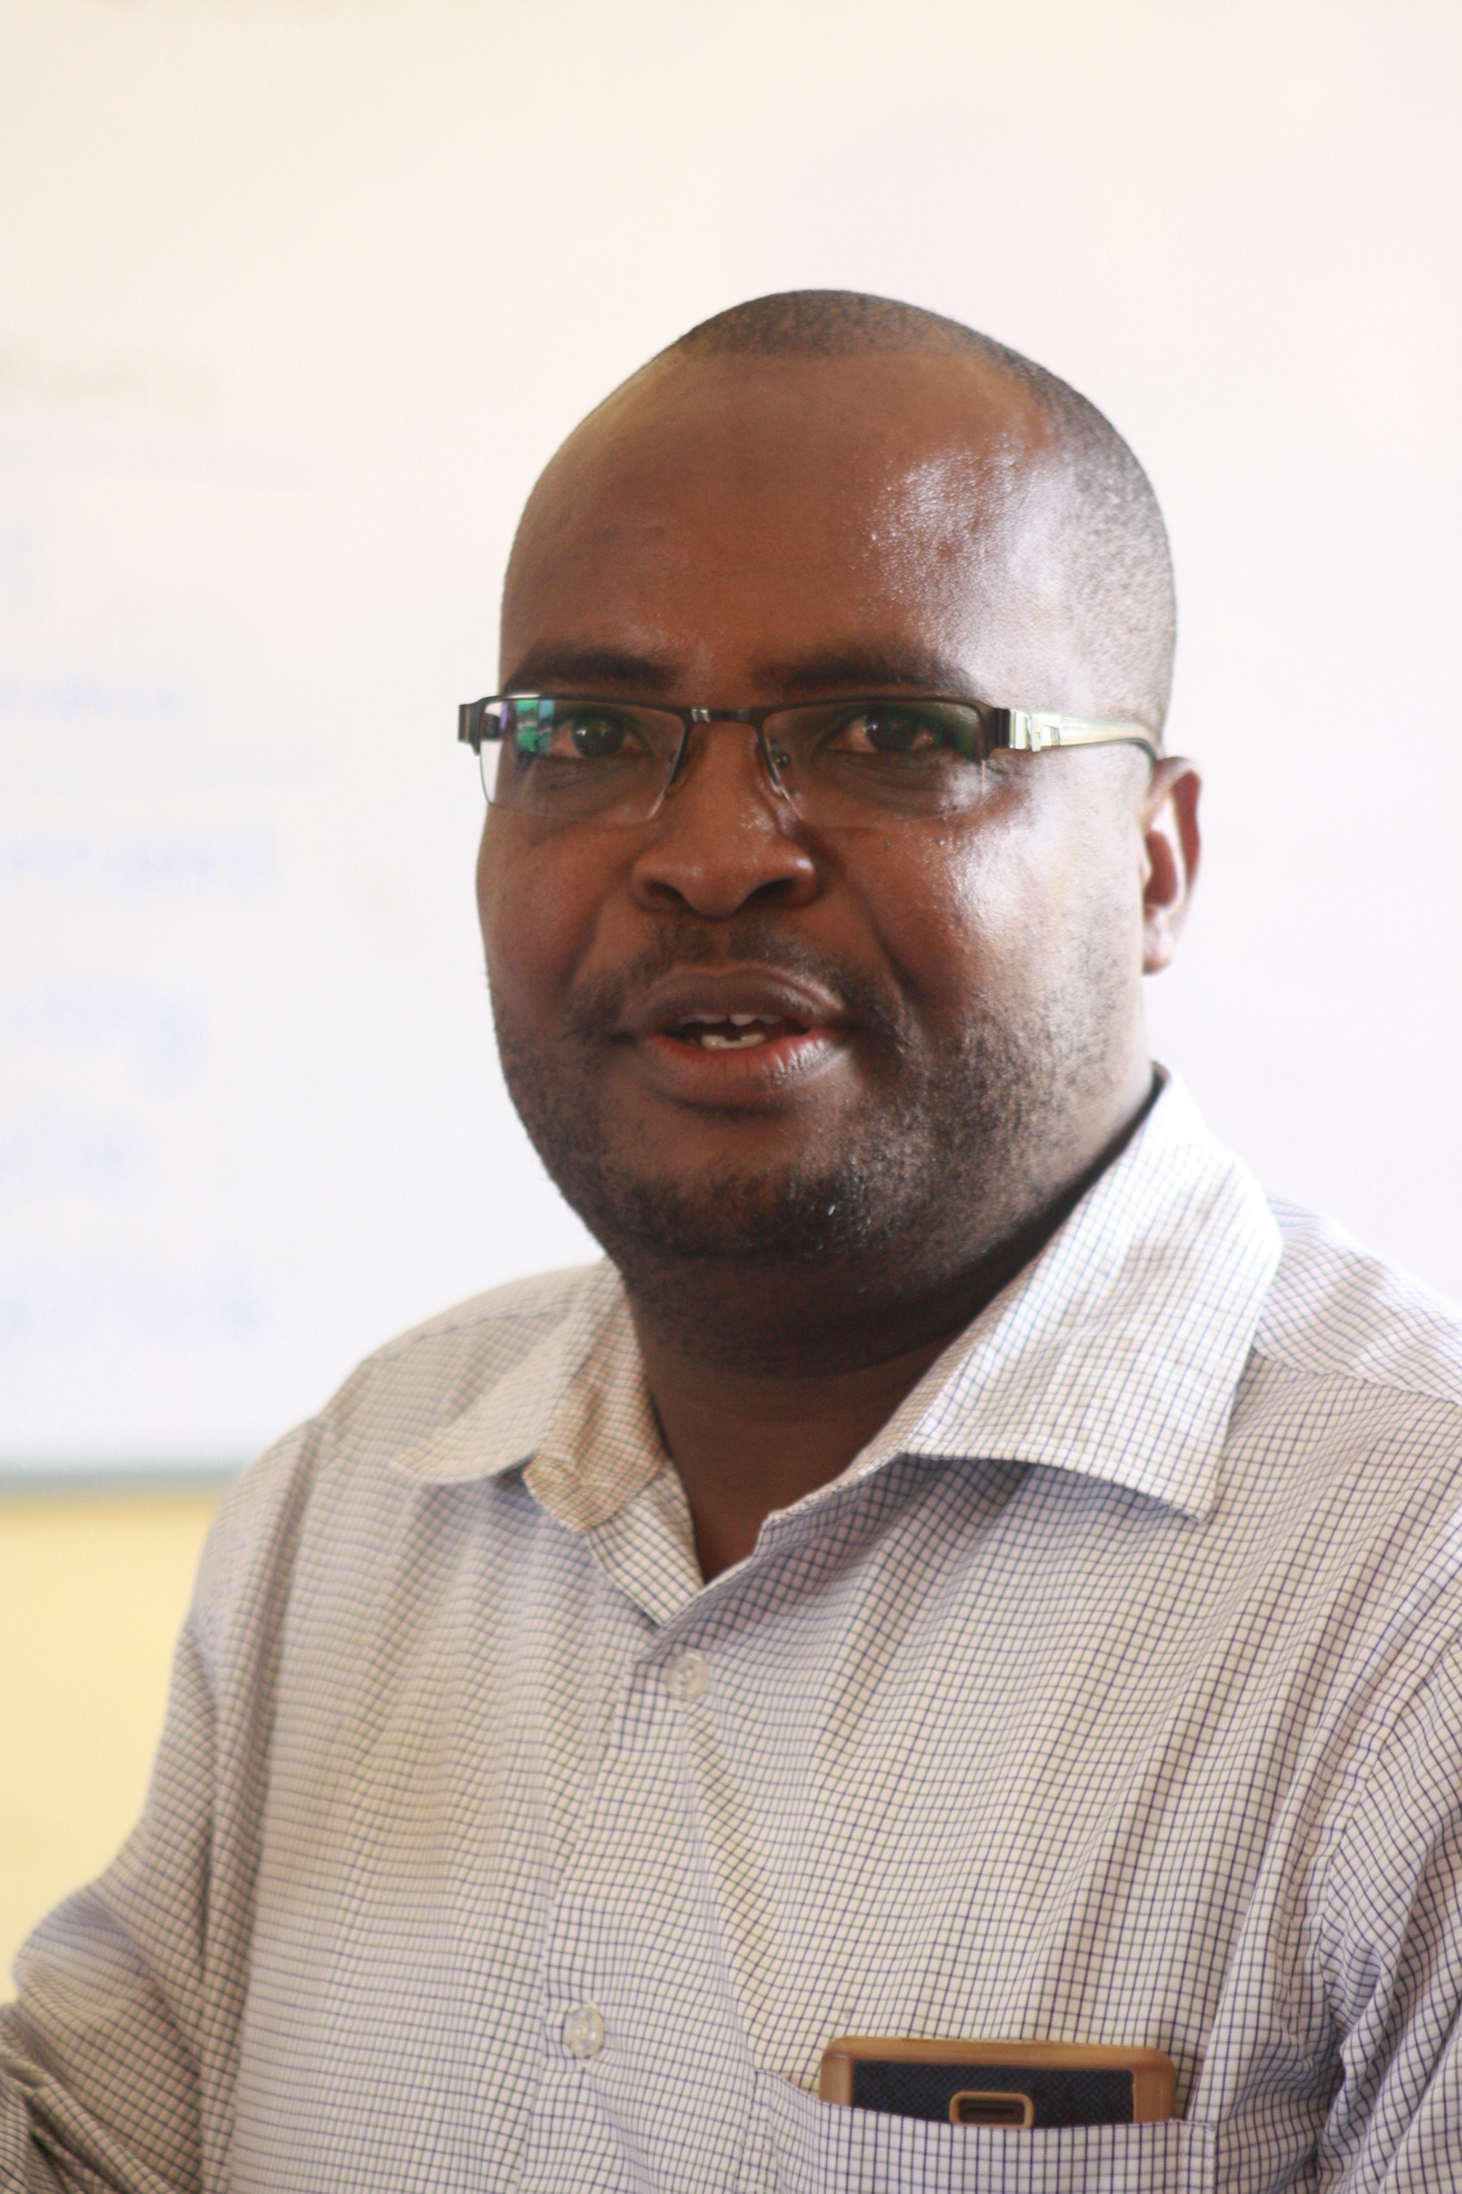
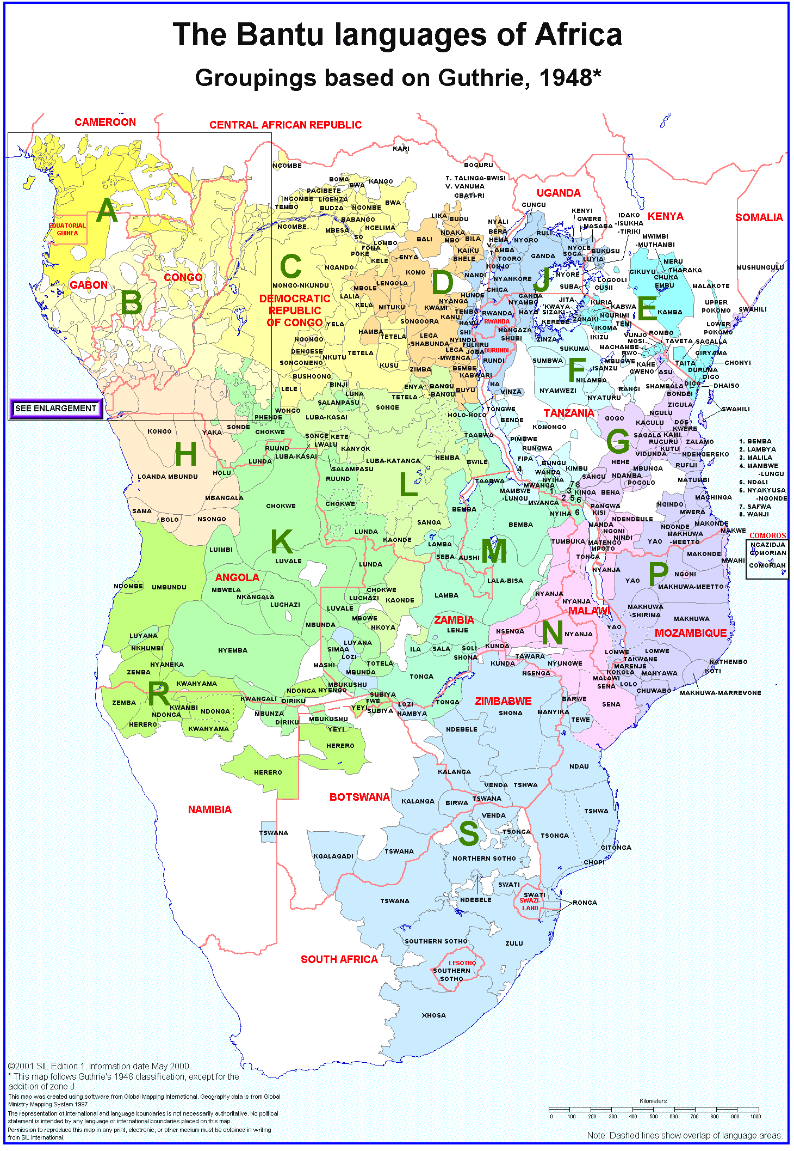



Patrick Kanampiu
University of Edinburgh
Kîîtharaka
Amani Lusekelo
University of Dar es Salaam
Nyakyusa
Allen Asiimwe
Makerere University
Rukiga
Ernest Nshemezimana
University of Burundi
Kirundi

Slide 3
Introduction
A particle based on -o appears in four of the 9 Bantu languages in the BaSIS project.
It is used to mark contrastive topics and we gloss it as a contrastive marker (CM), following Asiimwe & Van der Wal (2021)
(1) Mabúkú mó imauriré. Ma-buku ma-o ni-ma-ur-ire 6-book 6-cm foc-6sm-lost-pfv ‘As for the books, they are lost.’ [Kîîtharaka]
(2) Igifaraánsa có ndakívuga. i-ki-faraánsa ki-ó n-ra-ki-vúg-a aug-7-french 7-cm 1sg-dj.prst-7om-speak-fv ‘As for as French, I speak it (unlike English or Lingala, for example).’ [Kirundi]
(3) Ikinyangwa pakusya po bikusya. i-ki-nyangwa pa-ku-sy-a pa-o bi-ku-sy-a aug-7-banana.flour 16-15-grind-fv 16-cm 2sm-prs-grind-fv 'As for banana flour, they do the grinding.' [Kinyakyusa]
3

Slide 4
Introduction
The particle is structurally optional and only used with given referents, not focus.
(4) Naawuríiye, umuhwí (wó). n-a-a-wu-rí-ye u-mu-hwí u-ó 1sg.sm-pst-dj-3om-eat-pfv aug-3-banana 3-cm 'I have eaten it, the banana.’ [Kirundi]
(5) a. E-n-jojo z-á-ij-a aug-10-elephant 10-n.pst-come-fv ‘(The) elephants have come.’
b. E-n-jojo zó z-á-ij-a. aug-10-elephant 10-cm 10-n.pst-come-fv ‘As for the elephants, they have come (maybe the antelopes, the lions etc. have not shown up).’ [Rukiga]
4

Slide 5
Introduction
Aim of the talk:
To show the use and interpretation of the -o particle across the languages
Structure of the talk:
Origin as a pronominal element
Formal properties
Functional properties
NA+PRO
Conclusion
5

Slide 6
Origin as a pronominal element
Ashton (1945: 12) describes the “-o (and -e) of reference”
We encounter the particle as a pronominal element in the four Bantu languages, e.g., after na ‘with’ and as an enclitic:
(6) a. A-ka-zin-a ná=we. 1sm-f.pst-dance-fv with=1.pro ‘She danced with him.’
b. Tu-gyend-é ná=bo. 1pl.sm-go-sbjv with=2.pro ‘Let us go with them.’
(7) N-aa-bon-a=ho ó-mu-terere. 1sg.sm-n.pst-find-fv=16 aug-3-mongoose ‘I found there a mongoose.’ [Rukiga]
“This particle is used in contexts in which reference is made to something already mentioned, or which is in mind, or is in sight of the speaker. It also brings into prominence the word to which it refers.”
6

Slide 7
Formal properties
7

Slide 8
Formal properties
The particle can be used by itself (= with referent expressed as subject or object marker)
It can be interpreted here as a pronoun or a contrastive marker.
(8) Bó, baamaze kugenda kw’ishuúre. ba-ó ba-a-a-mar-ye ku-geenda kw’ i-shuúre 2-cm/pro 2.sm-n.pst-dj-finish-pfv 15-go 17 aug-5.school ‘As for them, they have already gone to school.’ [Kirundi]
(Asiimwe & Van der Wal 2021: 5)
(9) Bó baateek’ ómucéeri ba-o ba-aa-teek-a o-mu-ceeri 2-cm/pro 2sm-n.pst-cook-fv aug-3-rice ‘As for them (the women), they have cooked rice.’ [Rukiga]
(10) Bakûthi bo
Ba-kû-thí bó. 2sm-prs-go 2-cm/pro ‘As for them, they have gone’ / ‘They have gone, in fact.’ [Kîîtharaka]
8

Slide 9
Formal properties
The particle takes a class specific prefix, agreeing with its (overt or covert) antecedent:
(11) Mwé, ukweenda ko eendire! mwe u-ku-enda k-o a-end-ile excl aug-15-walk 15-cm 1sm-walk-pfv 'He (really) walked!’ [Kinyakyusa]
(12) Gw’ ábakázi báágutéeka. gu-o a-ba-kazi ba-aa-gu-teek-a 3-cm aug-2-woman 2sm-n.pst-3om-cook-fv ‘As for it (the rice) the women have cooked it.’ [Rukiga]
9

Slide 10
Formal properties
Typically appears after the noun in Kîîtharaka, Rukiga and Kirundi, but prenominal use is also possible for Kîîtharaka and Rukiga as in (13) and (14):
(13) {gwo} Á-ba-kázi {gwo} bá-á-gu-téek-a {gwo} aug-2-woman 3-cm 2sm-n.pst-3om-cook-fv
‘As for it (the rice) the women have cooked it. [Rukiga]
(14) {bo} A-rutwa {bo} ba-kaa-thi cukuru {bo} 2-learners 2-cm 2sm-fut-go 9.school
‘As for them (the learners), they will go to school.’ [Kîîtharaka]
Prenominal use is untenable in Kirundi:
(15) {*} A-bá-ana {bó} ba-a-maze ku-genda kw’ i-shuúre {bó}. aug-2-child 2-cm 2.sm-n.pst-dj-finish.pfv 15-go 17 aug-5.school ‘The children have already gone to school (but the women haven’t).’
[Kirundi]
10

Slide 11
Formal properties
In case of conjoined clauses (contrast between subjects), the particle can appear in the first clause (16a) or preferably the second clause, but not both – that would be overdoing it:
(16) (What is the woman eating and what is the man eating?)
a. Omukázi wé naaryá ápo, omushíija naary' ómunekye. o-mu-kazi w-o ni-a-ri-a apo o-mu-shaija ni-a-ri-a o-mu-nekye aug-1-woman 1-cm ipfv-1sm-eat-fv 9.apple aug-1-man ipfv-1sm-eat-fv aug-3-banana ‘The woman is eating an apple; the man is eating a banana.’
b. Omukázi arikuryá ápo, kándi wé omushííja arikurya' ómunekye. o-mu-kazi a-riku-ri-a apo kandi w-o o-mu-shaija a-riku-ri-a o-mu-nekye aug-1-woman 1sm-prog-eat-fv 9.apple and 1-cm aug-1-man 1sm-prog-eat-fv aug-3-banana ‘The woman is eating an apple while the man is eating a banana.’ [Rukiga]
(17) Gaceri aíníre rwî́mbó, Mwende weé áugá macaíri. Gaceri a-i-na-ire rû-îmbo Mwende û-e a-ug-a ma-cairi 1.Gaceri 1sm-sing-pfv 11-song 1.mwende 1-cm 1sm-say-fv 6-poem ‘Gaceri sang a song, Mwende, on her part, recited a poem.’ [Kîîtharaka]
11
Notes:
11

Slide 12
Formal properties
The particle is not compatible with a noun in a cleft (18) or pseudocleft (19):
(18) Ni abaana (*bo) baajé.
ni a-ba-áana ba-ó ba-əz-ye^{h}
cop aug-2-child 2-cm 2sm-come-pfv.rel
'It's the children who have come.' [Kirundi]
(19) Abaáje ni abaana (*bó).
a-ba-əz-ye^{h} ni a-ba-áana ba-ó
aug-2sm-come-pfv.rel cop aug-2-child 2-cm
'The ones who have come are the children.' [Kirundi]
For Kîîtharaka, the particle cannot be used with in-situ focus; the PCF verb form with ni- must be used instead:
(20) (He didn’t feed the donkey and the cows!)
*(N’)Árárû́míírie îng'ooí rîo. ni a-ra-rûm-ir-i-e î-ng’oi î-o foc 1sm-ypst-feed-pfv-ic-fv 5-donkey 5-cm ‘As for the donkey, he fed it.’ [Kîîtharaka]
12

Slide 13
Functional properties
13

Slide 14
Functional properties
The particle is used with topic, not focus.
(21) a. What have you eaten? Nariiye umuhwi (*wó). n-a-ø-rí-ye u-mu-hwí u-ó 1sg.sm-n.pst-cj-eat-pfv aug-3-banana 3-cm ‘I have eaten a banana.’
b. What have you done? Naaríiye umuhwí (*wó). n-a-a-rí-ye u-mu-hwí u-ó 1sg.sm-n.pst-dj-eat-pfv aug-3-banana 3-cm
c. Have you eaten the banana? Naawuríiye, umuhwí (wó). n-a-a-wu-rí-ye u-mu-hwí u-ó 1sg.sm-pst-dj-3om-eat-pfv aug-3-banana 3-cm 'I have eaten it, the banana.’ [Kirundi]
14

Slide 15
Functional properties
The use of the -o particle is context-dependent strategy for encoding contrastive meaning.
a. (Context: You weren’t expecting other animals)
Enjojo záija. e-n-jojo za-ij-a. aug-10-elephant 10sm-n.pst-come-fv (The) elephants have come.
b. (Context: You were expecting other animals)
Enjojo zó záija. e-n-jojo z-o za-ij-a. aug-10-elephant 10-cm 10sm-n.pst-come-fv ‘As for the elephants, they have come (maybe the antelopes, the zebras, the lions etc. have not shown up).’ [Rukiga, Asiimwe & Van der Wal, forthcoming]
15

Slide 16
Functional properties
The particle serves as a topic marker in Kîîtharaka, Rukiga and Kirundi. As such it expresses contrastive topic, with five possible context driven interpretations:
(23) Mbúra yoó îkuúra m-bura î-o î-kû-ura 9-rain 9-cm 9sm-prs-rain ‘It has (indeed/really) rained (but...)’ [Kîîtharaka]
Contrast: There was a weather forecast that predicted there would rain
accompanied by heavy storm
Truth focus: Has it really rained? I do not trust what Edith says.
Intensive: I hear you received some good amount of rainfall unlike other times! Depreciative: It has rained but you think it won’t help because the crops had already withered.
Mirative: see (24)
16

Slide 17
Functional properties
Rukiga has an additional mirative interpretation:
(24) O-kw-óg-a kw-é n-áá-yog-a. aug-15-swim-fv 15-cm 1sg.sm-n.pst-swim-fv ‘I have indeed/really swum (but…).’ [Rukiga]
Contrast: I was expected to swim and play baseball.
Truth: Pool attendant sees me walking away from the pool area showing no sign that I entered the water.
Intensive: I went into the pool and swam for a long time with lots of energy.
Depreciative: The water was too cold but I went ahead and swam anyway.
Mirative: I have always feared to get into the water but hey I can swim!
The same interpretations can be realised in predicate doubling constructions, where the
use of the particle is optional and seems to add the same effect (see presentation Lusekelo
et al.).
17

Slide 18
Functional properties
This situation is however different for Kinyakyusa where the discourse functionality of the particle is greatly reduced–only classes 16 po and 15/17 ko are functional. It can’t function as a contrastive topic marker as in (24):
(24) Abalimi (*bo) mbapeele îfijîînja; abafwimi (*bo) ngabapa.
a-ba-limi bo m-ba-pa-ile i-fi-jinja a-ba-fwimi bo n-ka-ba-p-a
aug-2-farmer 2.cm 1sg.sm-2om-give-pfv aug-8-banana.tree aug-2-hunter 2.cm 1sg.sm-neg-2om-give-fv
'The farmers I gave banana trees; the hunters I didn't give.'
This may be related to the fact that -o has developed to an identificational copula in Kinyakyusa, as shown in the contrast between predicational and specificational non-verbal predication in (25).
(25) a. (Who is the teacher in this classroom?) (specificational)
Ummanyisi *(jo) nkikuuru uju.
u-m-manyisi jo n-kiikuru uju
aug-1-teacher 1.id.cop 1-woman 1.dem.prox
‘The teacher is this woman.’
b. What does Hobokera do for a living? (predicational)
Hobokera m-manyisi
1.Hobokera 1-teacher
‘Hobokera is a teacher.’
18

Slide 19
Functional properties
Additionally, for Kinyakyusa, the marker seems to be further developing into a pragmatic particle, introducing new topics and/or marking a discourse boundary, as in (26). This, however, requires further investigation and is outside of the scope of this presentation.
(26) (Context: discussion about elections and a local candidate).
Po ikampeni akomelaga kuugu?
po i-kampeni a-kom-el-ag-a ku-ugu
then aug-9.campaign 1sm-hit-appl-hab-fv 17-where
'Now where did he do campaigns?’ [Kinyakyusa]

Slide 20
O-particle in different clothing!
Also used with na ‘with’, ‘and’, ‘also’ or ‘even’ - for additive (focus) meaning (Marten, 2013)
The combination na+pro follows a noun, and it marks the non-initial topic
(28) (Did you see the crested cranes?) N-aa-reeb-a é-n-tuuha, e-n-dahi na-zó n-áá-zí-reeb-a. 1sg.sm-see-fv aug-10-crested.crane aug-10-dove and-10.pro 1sg.sm-n.pst-10om-see-fv ‘I saw crested cranes, and also doves.’ [Rukiga]
(29) (Who else has brown eyes in your class?)
Mûtúgí wana wé árî́ na meetho mátuúne. Mûtugi wana we a-rî na ma-itho ma-tune 1.Mûtugi also 1.pro 1sm-be with 6-eyes 6-red 'Mûtugi among others/even/also he has brown eyes.' [Kîîtharaka]
20
Notes:
20

Slide 21
O-particle in different clothing!
The na+ pro marker can only mark the second topic (the shift or contrast).
(30) (What did Souza do with the beans and the carrots?) Mboócó (*nació) n' árarugire, kaaráti nacíó, éendíá. m-booco na-ci-o ni a-ra-gur-ire kaarati na-ci-o a-endi-a 10-beans and-10-pro foc 1sm-ypst-cook-pfv 10.carrots and-10-pro 1sm-sell-fv 'The beans he cooked and the carrots he sold.' [Kîîtharaka]
(31) Yaareeb’ éntéb’ (é)nnungi (*nazó) n’embí (nazó) yáázíreeba. a-a-reeb-a e-n-tebe e-n-rungi na-zo na e-n-bi a-a-zi-reeba 1sm-n.pst-see-fv aug-10-chairs aug-10-good and-10.pro and aug-10-bad 1sm-n.pst-10om-see ‘He saw good chairs, and bad ones he also saw.’ [Rukiga]
21
Notes:
21

Slide 22
Additive vs shift topic na+pro
Overlap where both interpretations are plausible: as an additive marker and shift topic marker.
Kaana kaugia, gakurû nakoó i kaugîîtie. ka-ana ka-ugi-a ka-kurû na-ka-o ni ka-ug-ît-i-e 12-child 12sm-run-fv 12-dog with-12-pro foc 12sm-run-pfc-ic-fv ‘The child ran, while the little dog was also running.’
[Kîîtharaka]
22

Slide 23
Narrative-structuring na+pro
In addition to marking a shift topic na+ pro also functions as a narrative-structuring device, switching between different referents.
(Hare grabs Hyena and begins raining hot blows on him. Hyena cries ‘My husband, the
mighty one, leave me! Leave me alone!’) Kayû́gû́ nakó n’wa kûmî́rumia mmá! mmá! ka-yûgû na-ko ni-w-a ku-mî-rum-i-a mma mma 12-hare and-pro cop-1-conn 15-9om-beat-sc-fv ideo ideo ‘Hare, for him, he kept on beating Hyena: whack! whack!’ [Kîîtharaka]
More on composition and syntactic restrictions-next presentation (Hannah & Lutz)
23
Notes:
Hyena and Hare and the protagonists, and the story alternates between the actions of the one and those of the other.
23

Slide 24
Conclusions
-o is used as a contrastive topic marker in all three languages
The extra 'flavours' of intensity, depreciation, and mirativity come for free in the right context
Kinyakyusa is more restricted in only having po and ko, and on the other hand these show a wider use, also on the discourse level
The particle prefers a postnominal use, attached to a noun in the left periphery of the sentence, but appears flexible in its position
The particle can also appear by itself, or perhaps in a different vision as modifying an accessible referent that is not expressed by a noun phrase (but by a subject or object marker)
24

Slide 25
Further questions
If topic predicate doubling and -o are both used with a contrastive topic meaning, what is the result of combining them, in interpretation and use?
Which stages between pronoun and particle use can be postulated, and can we find evidence for them?
Should -o in its use as contrastive topic marker be analysed as the spell-out of a ContrTopP head in the syntax?
If so, how should we deal with the use of the particle in other positions than the left periphery? An alternative: the marker forms part of the noun phrase.
Can we trace which languages the o- of reference developed into contrastive topic and in which it became an identification copular
25

Slide 26
The end
Thank you!
Comments and questions are welcome!
26

Slide 27
References
Ashton, E. (1945). Notes on Form and Structure in Bantu Speech. Africa, 15(1), 4-20. doi:10.2307/1156825
Asiimwe, Allen, and Jenneke van der Wal. 2021. The multifunctionality of -o in Rukiga: pronoun, contrastive topic, and mirative marker. Nordic Journal of African Studies 30 (1).

Slide 28
Formal properties
Contrasted in subjects take obligatory SM while non-subjects (naturally fronted) take obligatory OM in Rukiga and Kirundi, as in (13) and (14):
(13) Bó baateek’ ómucéeri
ba-o ba-aa-teek-a o-mu-ceeri 2-cm 2sm-n.pst-cook-fv aug-3-rice
‘As for them (the women), they have cooked rice.’ [Rukiga]
(14) (Did he iron the clothes?)
Amashaáti yaayagooroye aríko amasume (yó) yayaretse uko.
a-ma-shaáti a-a-ya-gooror-ye. aríko a-ma-sume a-ó a-a-ya-rek-ye uko
aug-6-shirt 1sm-n.pst-6om-iron-pfv but aug-6-towel 6-cm sm-n.pst-6om-leave-pfv like.that
'The shirts, he has ironed them but (as for) the towels, he has left them like that.’
[Kirundi]

Slide 29
Formal properties
For Kîîtharaka, only human non-subjects take obligatory OM:
(15) Mabuku mo Brian n’a(ma)teere
mabuku ma-o Brian ni a-ma-ta-îre 6-books 6-cm 1.Brian foc 1sm-om-lose-pfv
‘As for the books, Brian lost them.’ [Kîîtharaka]
(16) Kimaathi we Brian n’a*(mû)keethiirie
Kimathi û-e Brian ni a-mû-keeth-i-îr-e 6-books 1-cm 1.Brian foc 1sm-om-greet-ic-pfv-fv
‘As for Kimathi, Brian greeted him.’ [Kîîtharaka]

